Slide 1


8th conference of Myanmar Society of Hematology
Comparative Outcome of Azacytidine -Venetoclax
versus
Intensive Therapy in Acute Myeloid Leukemia
Single Centre Experience at Department of
Clinical Haematology, North Okkalapa General Hospital
Yi Mon Thant, Hnin Mya Thanda,Mie Mie Khaing,Yin Nwet Han,Sein Win, Khin Thida Htut,Aye Aye Gyi

Slide 2
Background
Intensive induction chemotherapy remains the standard treatment approach for fit adults acute myeloid leukemia (AML).
However,its implementation in resource limited settings is quite challenging due to inadequate supportive care .
Venetoclax,a BCL-2 inhibitor,has significant clinical benefit in elderly or medically unfit AML patients,though its efficacy in induction-eligible adults is not well established.

Slide 3
Despite,we treated many AML patients for several years,
approximate wo-third of patients were lost during
chemotherapy,also in relapse setting.

Slide 4
METHODS
Retrospective analysis : newly diagnosed de-novo AML
Place: Department of Clinical Haematology, NOGH
Period: January 2025 to Feburary 2026 ( 14 months period)
Total Patient- 124 AML
OS - analyzed using Kaplan-Meier survival analysis.
 | Aza-Ven | 3+7
Induction | azacytidine 100mg 7days+ low-dose venetoclax 100mg 14-28 days incombination with voriconazole | Two courses- Standard (3+7) induction (Doxo/Dauno. x 3days + AraC x 7 days
Consolidation | Azaven monthly | Three courses of High dose AraC
Maintenance | Azaven till relapse | Aza or PO 6MP,Mtx

Slide 5
RESULTS
Patients’ characteristics
A total of 124 AML –Azaven-31
- 3+7 - 93
Age: Median age was 40 (range 12-80 years) in 3+7
versus 68 (range 31-82 years) in aza-ven group
Gender: 56%-females, and male to female ratio 4:5 in
both groups
Genetic risk assessment by FISH is available only in –
39 cases (41.93%) in 3+7 versus
12 (38.70%) in aza-ven group

Slide 6
Risk profile
Aza+Ven treatment
3+7 treatment

Slide 7
AzaVen (31)
3+7 (93)
31 AML
93 AML
ID 4( 12.9 %)
ED 12( 12.9 %)
27
81
Abandon 1(3.2%)
ID 19 ( 20.4 %)
62
26
Abandon 9 ( 9.6%)
Consoldation death
4 ( 12.9 %)
53
Consolidation death 5 (5.3%)
22
48
Relapse 5 ( 16.1%)
Relapse 1(1%)
17 ( 54.83 %)
47(50.53 %)

Slide 8
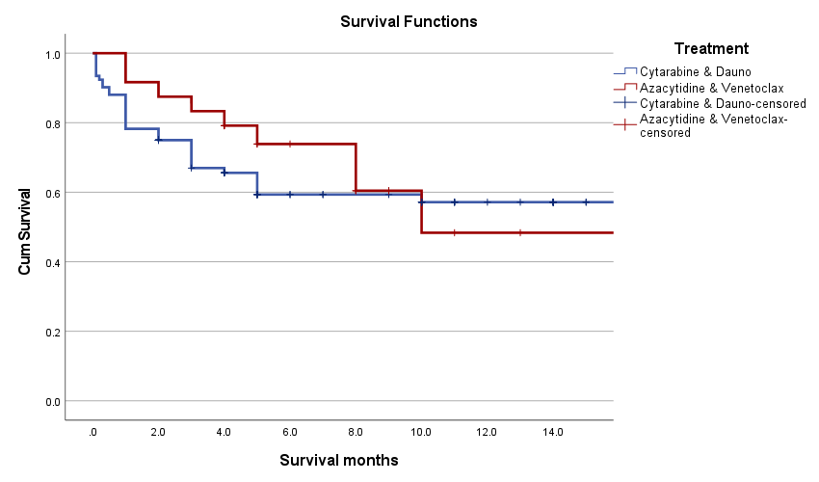
Comparative Survival of AML by Kaplan-Meier Survival Analysis

Slide 9
Kaplan–Meier survival analysis demonstrated no statistically significant difference in survival between patients treated with ICH(Cytarabine plus Daunorubicin) and those treated with Azacitidine plus Venetoclax
(log-rank test, p = 0.647).

Slide 10
Aza-Ven
3+7 (ICH)
> 30days survival 91.7%
(P-0.24),
> 60days survival 87.5%
(P-0.19)
>30days survival 78.3%
(P-0.24)
> 60days survival 75%
(P-0.19)

Slide 11
Mean survival was 10.986 (95% CI 8.235-13.737) in aza-ven versus
10.923 (95% CI 9.140-12.707) in ICH group ,
overall 10.963 months (95% CI 9.442-12.485).
Median survival was 10.00 (95% CI 3.871-16.129) in aza-ven versus
16.00 (95% CI 6.111-25.889) in ICH group,
overall 16.00 months (95%CI 9.336-22.664).
These findings suggest comparable survival outcomes between the two treatment regimens.

Slide 12
At the end , out of 31 Non-APL patients,17 ( 54.83 %) patients are still alive in aza-ven group versus
Out of 93 Non-APL patients,47 (50.53%) are still alive in ICH(3+7) group.

Slide 13
Conclusion:
Despite the aza-ven cohort demonstrating a high risk profile of older age, adverse risk , the regimen showed notable safety advantages of lower early mortality , fewer treatment-related complications , shorter hospital stays with comparable overall efficacy in terms of CR,OS.
It also offer a safer , equally effective alternative to ICH in low-resource settings

Slide 14
Recommendation:
Because of lower induction death and
higher relapse rate in aza-ven compared to ICH,
aza-ven induction followed by consolidation with ICH
would be a better option for longer survival of AML patients.

Slide 15
THANK YOU SO MUCH

Slide 16
Although the median survival appeared longer in the ICH group (16 months) compared with the Aza-ven group (10 months), the confidence intervals were wide and overlapping.
The mean survival times were similar in both groups (10.9 vs 11.0 months). These findings suggest comparable survival outcomes between the two treatment regimens.

